Slide 1

Back to Basics
Principles of Sound

Slide 2
Overview
A brief history of the Universe of acoustics (Ruth)
Acoustics Intro (Kait)
Math refresher
Break!
Measurements (Kait)
Continuous/Impulsive
Python Bootcamp
Reading List, sound measurements and JASCO Pocket guide (reference)
https://tethys.pnnl.gov/sites/default/files/publications/jmse-09-00173.pdf
https://www.oceansinitiative.org/wp-content/uploads/2012/07/PocketBook-3rd-ed.pdf

Slide 3
What is sound
Changes in density (compression and expansion)
Air, water, sound, electromagnetic, gravity

Slide 4
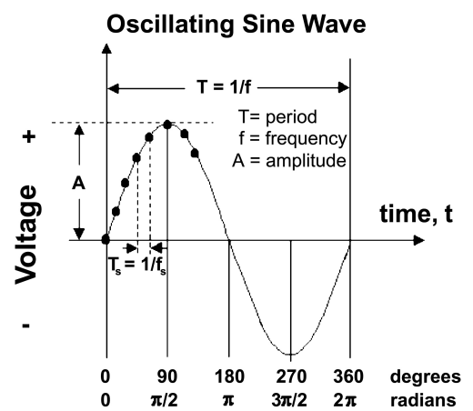
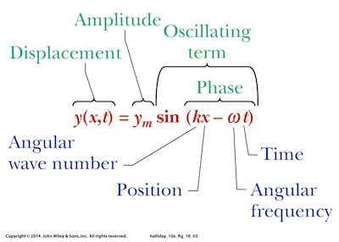
Critical measures:
Amplitude (A, unitless),
Wavelength (λ, m)
Period (τ,s)
Phase (ϕ, radians)
k - the wave number (1/λ),
ω - angular frequency (π/τ)

Slide 5
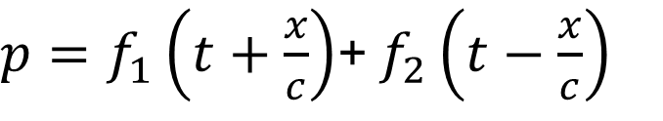
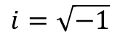
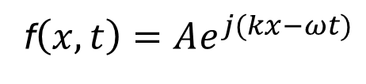
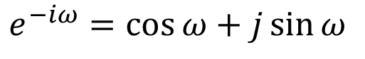
Important Relationships:
Wave moving +x
Wave moving -x
$p=f_{1}\left(t+\frac{x}{c}\right)$+ $f_{2}\left(t−\frac{x}{c}\right)$
c =λf
k=ωc
k=2π/ λ
Some fun. f₁
Some fun. f₂
f$\left(x,t\right)=Ae^{j(kx−ωt)}$
$$i=\sqrt{−1}$$
Real part (amplitude)
$e^{−iω}=\cos{ω⁡}+j\sin{ω}$
Imaginary/complex part (phase)

Slide 6
MATH BREAKOUT!

Slide 7
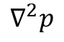
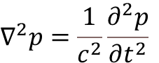
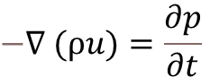
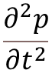
$$−∇ (ρu)=\frac{∂p}{∂t}$$
change in particle velocity leads to a change in pressure. The pressure drives the particle motion, which feeds back into pressure changes, completing the cycle of wave propagation.
$$∇^{2}p=\frac{1}{c^{2}}\frac{∂^{2}p}{∂t^{2}}$$
$$∇^{2}p$$
how pressure (previously displacement) varies spatially in all directions.
$$\frac{∂^{2}p}{∂t^{2}}$$
how pressure changes over time (its second derivative with respect to time)
if pressure varies spatially, it drives temporal acceleration

Slide 8
Boundary Conditions
Rigid, fixed; Displacement & velocity=0
Free, pressure release; pressure =0

Slide 9
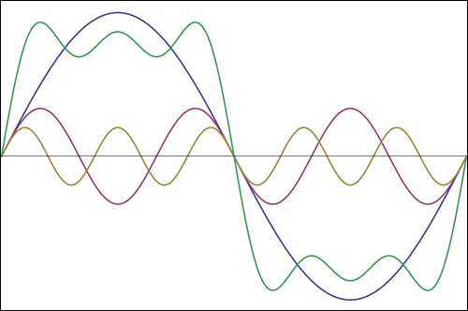

Interactions
Most sound combination of different harmonic waves at different amplitudes and frequencies
Results in constructive and destructive interference
Can sum multiple harmonic waves to make any shape
$A\sin\left(ωt±kx\right)+A\sin\left(ωt±kx+φ\right)=2A\cos\left(\frac{φ}{2}\right)∗\sin\left(ωt±kx+φ/2\right)$

Slide 10
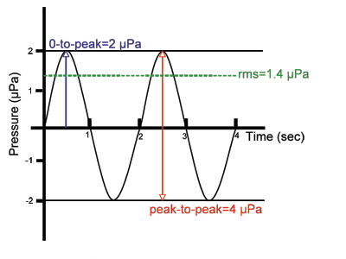
Measurements
0-to peak
RMS
Peak-to-peak

Slide 11




Measurements
Intensity- amount of energy transmitted per unit time through a unit area
$$I={\left(\frac{p^{2}}{ρc}\right)}_{average}$$
$$mean square={\left(p^{2}\right)}_{average}$$
$${rms=\sqrt{p^{2}}}_{average}$$
$ρc$= specific acoustic impedance, characteristic impedance:
opposition of a medium to wave propagation
𝜌 = $density of the medium$ (kg/m³)
c = speed of sound in the medium

Slide 12
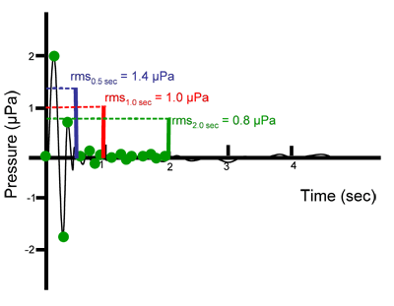
Impulsive Signals
Duration over which signal is averaged | rms pressure
0.5 sec | 1.4 µPa
1 sec | 1.0 µPa
2 sec | 0.8 µPa
www.dosits.org

Slide 13
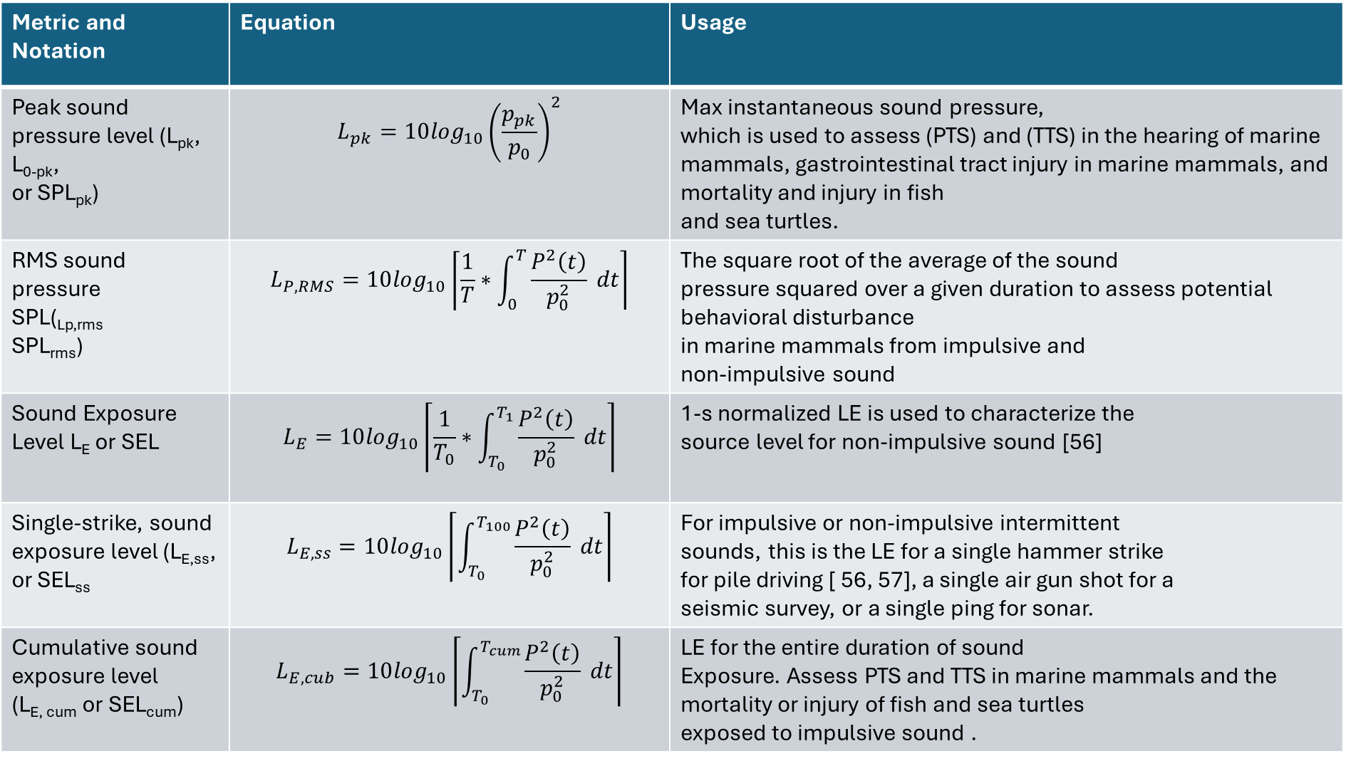
Metric and Notation | Equation | Usage
Peak sound pressure level (L_{pk}, L_{0-pk}, or SPL_{pk}) | $$L_{pk}=10\log_{10}{\left(\frac{p_{pk}}{p_{0}}\right)}^{2}$$ | Max instantaneous sound pressure, which is used to assess (PTS) and (TTS) in the hearing of marine mammals, gastrointestinal tract injury in marine mammals, and mortality and injury in fish and sea turtles.
RMS sound pressure SPL(_{Lp,rms} SPL_{rms}) | $$L_{P,RMS}=10\log_{10}\left\lceil \frac{1}{T}∗\int_{0}^{T}{\frac{P^{2}\left(t\right)}{p_{0}^{2}}} dt\right\rceil$$ | The square root of the average of the sound pressure squared over a given duration to assess potential behavioral disturbance in marine mammals from impulsive and non-impulsive sound
Sound Exposure Level L_{E} or SEL | $$L_{E}=10\log_{10}\left\lceil \frac{1}{T_{0}}∗\int_{T_{0}}^{T_{1}}{\frac{P^{2}\left(t\right)}{p_{0}^{2}}} dt\right\rceil$$ | 1-s normalized LE is used to characterize the source level for non-impulsive sound [56]
Single-strike, sound exposure level (L_{E,ss}, or SEL_{ss} | $$L_{E,ss}=10\log_{10}\left\lceil \int_{T_{0}}^{T_{100}}{\frac{P^{2}\left(t\right)}{p_{0}^{2}}} dt\right\rceil$$ | For impulsive or non-impulsive intermittent sounds, this is the LE for a single hammer strike for pile driving [ 56, 57], a single air gun shot for a seismic survey, or a single ping for sonar.
Cumulative sound exposure level (L_{E, cum} or SEL_{cum}) | $$L_{E,cub}=10\log_{10}\left\lceil \int_{T_{0}}^{T_{cum}}{\frac{P^{2}\left(t\right)}{p_{0}^{2}}} dt\right\rceil$$ | LE for the entire duration of sound Exposure. Assess PTS and TTS in marine mammals and the mortality or injury of fish and sea turtles exposed to impulsive sound .
https://tethys.pnnl.gov/sites/default/files/publications/jmse-09-00173.pdf

